Slide 1
NYC Open Data
Education Demographics and SAT Scores
Cesar Espitia and Duubar Villalobos
December 9, 2018
Notes:
1

Slide 2
Contents
Problem
Methodology and Data Collection
Validation
Analysis
Conclusion
Notes:
2

Slide 3
Problem
Problem
NYC Open Data provides various types of data sources to the public. For this final project, we focused on determining if there is a link between school student composition and SAT scores.
Demographic data is collected by schools across the five (5) buroughs that are similar to the Census data the US government collects. There were 8,867 records over five (5) years (2011-2016). The SAT score data was only available for 2012.
Our goal was to determine if we could predict average SAT scores based upon school demographic data?
Notes:
3

Slide 4
Methodology
The data was obtained through the NYC Open Data portal as CSVs for import in R:
2011 – 2016 Demographic Snapshot (https://data.cityofnewyork.us/Education/2011-2016-Demographic-Snapshot/8mzw-jfss)
2012 SAT Results
(https://data.cityofnewyork.us/Education/2012-SAT-Results/f9bf-2cp4)
There were 8,818 records over five (5) years (2011-2016). The SAT score data was only available for 2012 and contained 478 rows of information.
Sample column information includes Grade PK to Grade 12 student counts, ethnicity breakdowns, ratio of Males and Females and SAT scores by Module.
Notes:
4

Slide 5
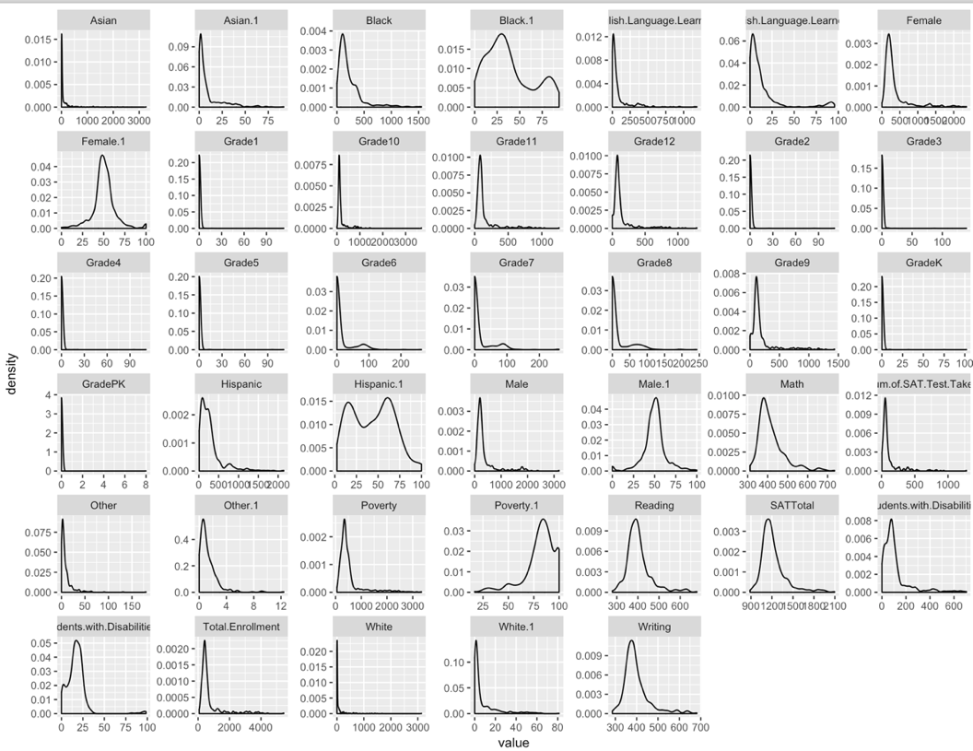
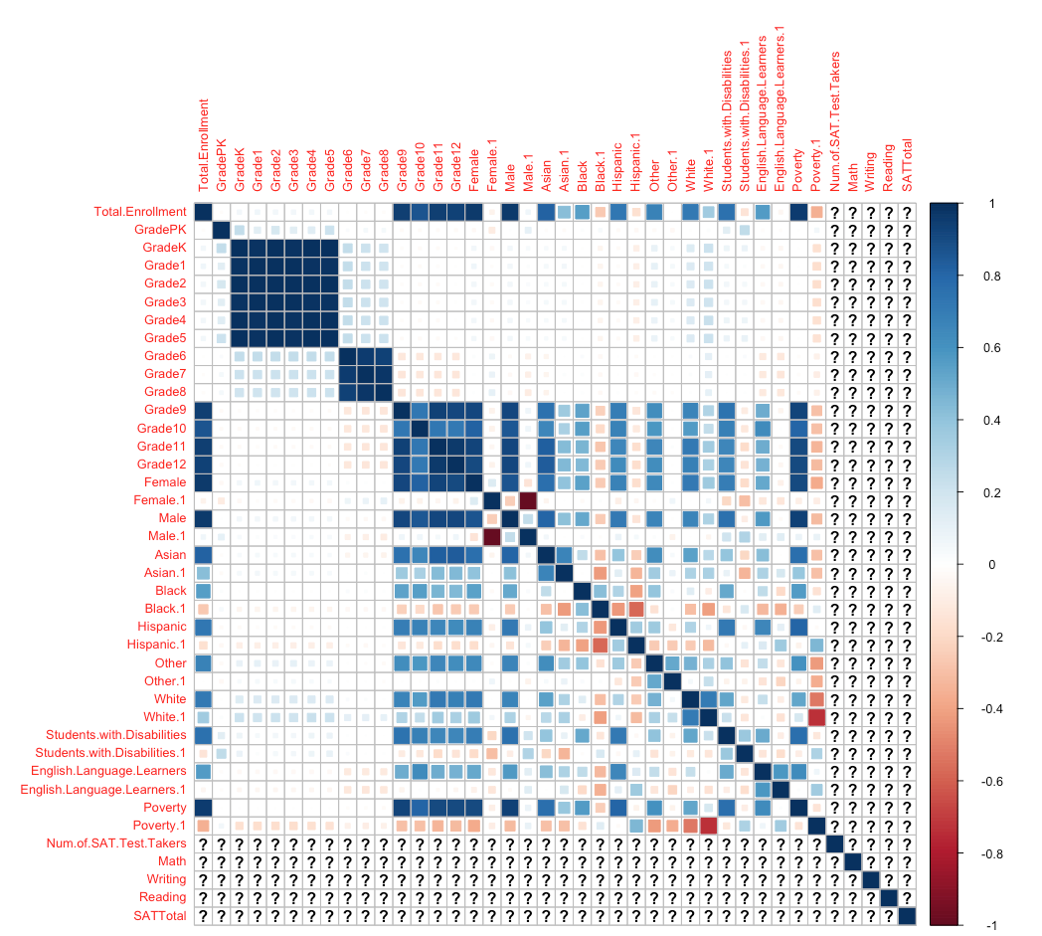
Validation
NY City School Demographic Data
Of particular interest is the distribution of the numerical data. Although it appears that a lot of the data is either right skewed or left skewed, this isn’t the case when the scaling is adjusted.
For the correlation plot, the ethnicity data correlated with itself highly. From this, only the percentages were kept instead of both count and percentage.
Notes:
5

Slide 6
Validation
In preparing the data the following steps were taken for Model 1 and Model 2
MODEL 1: Linear Model
The NA data (10%) of the final subset was imputed using the mean of the total data
No new variables were created
No transformations on available variables due to non-normality
MODEL 2: Difference Equations & Linear Model
Used completed cases only
Used school data with 5 years worth of records
No new variables were created
No transformations were used
A linear model was used in order to determine “k” from 5 years worth of data
Notes:
6

Slide 7
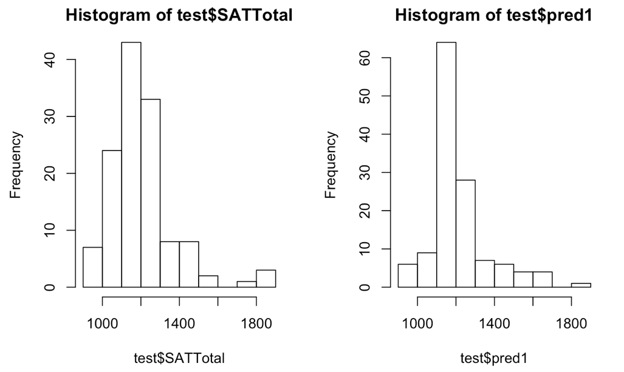
Analysis: Model 1
Once the model data was created, the question of SAT score prediction by school was created. The results are as follows:
MODEL 1 was generated using a generalized linear model using the gaussian method to predict the scores. Math, Reading and Writing were excluded as they are encompassed in the target variable SATTotal.
glm(formula = SATTotal ~ . - Math - Writing – Reading – Num. SAT.TestTakers, family = gaussian(), data = train)
AIC score of 3169.7
Main variables that were significant were, Poverty percentage, Number of Test Takers and Grade 9 Student counts
The prediction scores were in line with the actual scores by school
Notes:
7

Slide 8
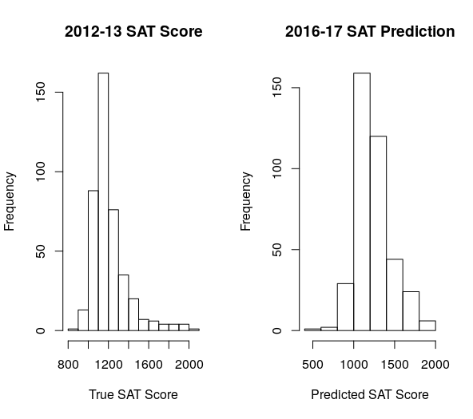
Analysis: Model 2
Once the model data was created, the question of SAT score prediction by school was created. The results are as follows:
MODEL 2 was generated by first estimating values using Difference Equations and then using a generalized linear model using the poisson method to predict the scores. Math, Reading and Writing were excluded as they are encompassed in the target variable SATTotal.
New values were estimated for each variable in order to obtain 2016-17 estimations
Once estimations were available a linear model was employed to predict SAT scores
The AIC score was 3600.7
Notes:
8

Slide 9
Conclusion
Two (2) models were presented after exploring and manipulating the data as necessary.
With using a multi-criteria approach for this exercise, it became clear that the Model 2 was selected and provided an AIC of 3600.7 which was adequate for the data but doesn’t necessarily indicate the best model if it were solely based upon AIC (Model 1 would have been chosen) which is the equivalent of R-squared for binary regression models.
If more data was available in the NYC School data, the creation of other new variables that were not correlated could have been generated with better insight into the data set.
Notes:
9

